Slide 1
Lecture 3: Deep Learning, Recurrent Neural Networks

Slide 2
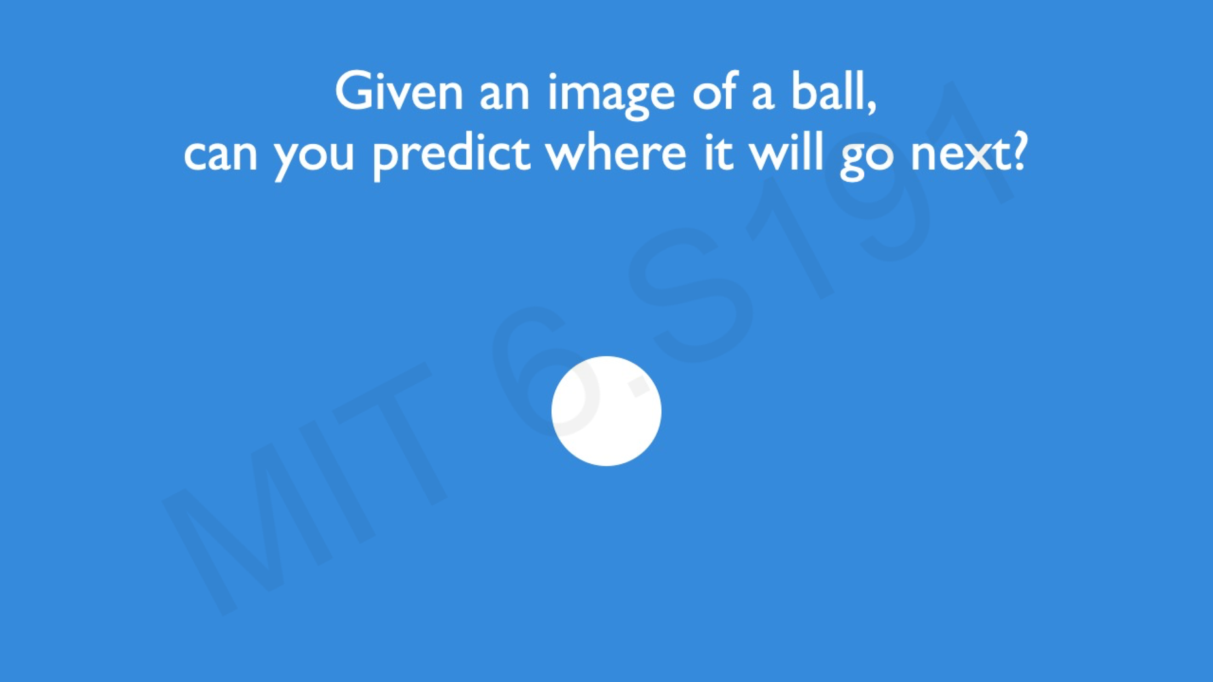
Recurrent Neural Networks

Slide 3
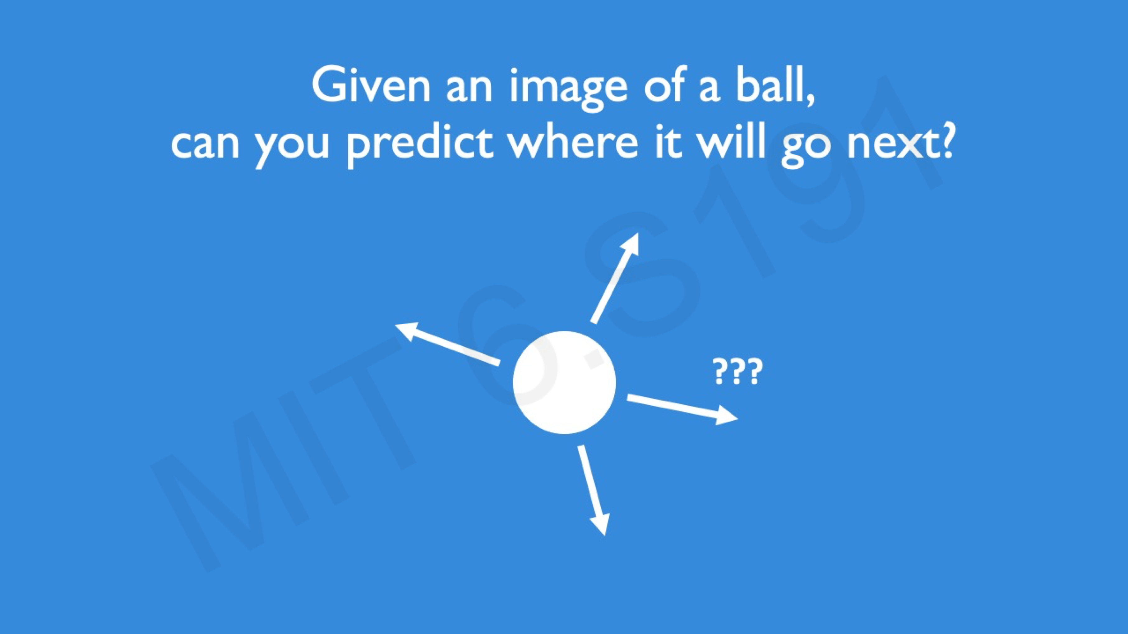
Recurrent Neural Networks

Slide 4
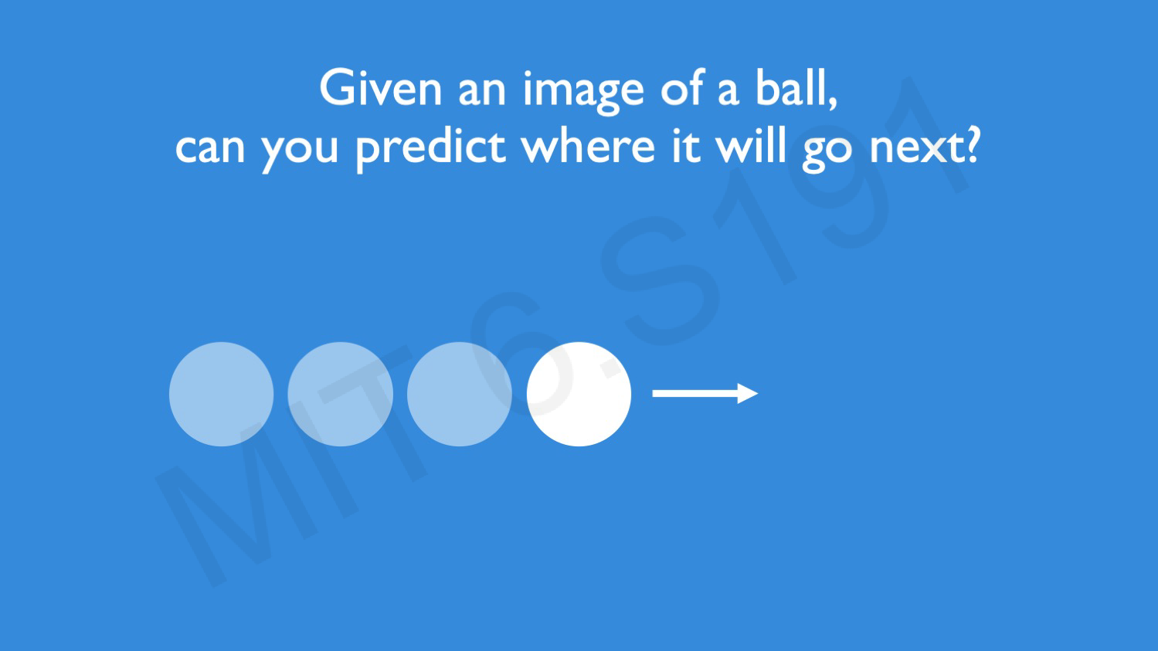
Recurrent Neural Networks

Slide 5
Recurrent Neural Networks
Often data arise as sequences:
Documents are sequences of words, and their relative positions have meaning.
Time-series such as weather data or financial indices.
Recorded speech or music.
Handwriting, such as doctor’s notes.
RNNs build models that take into account this sequential nature of the data, and build a memory of the past.
The feature for each observation is a sequence of vectors
X = {X₁, X₂,. .., X_{L}}.
The target Y is often of the usual kind — e.g. a single variable such as Sentiment, or a one-hot vector for multiclass.
However, Y can also be a sequence, such as the same document in a different language.

Slide 6
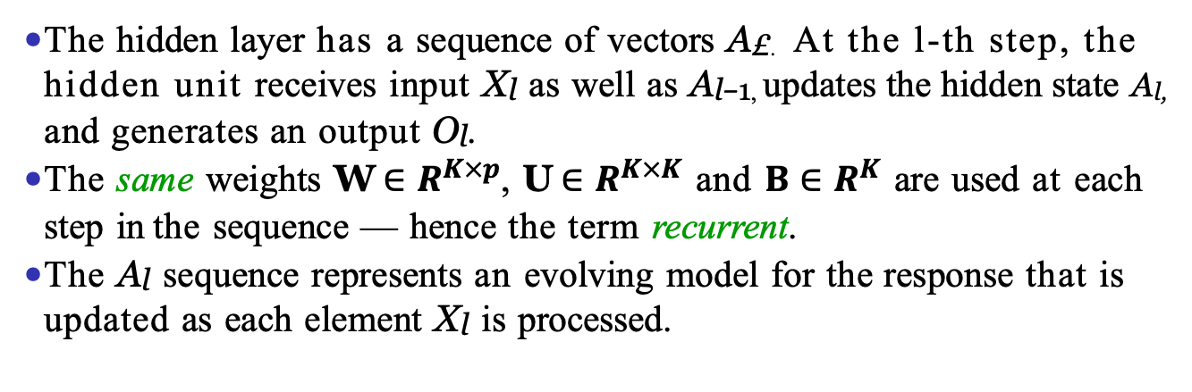
Simple Recurrent Neural Network Architecture
The hidden layer has a sequence of vectors A£. At the l-th step, the hidden unit receives input X_{l} as well as A_{l−1,} updates the hidden state A_{l,} and generates an output O_{l}.
The same weights W $∈R^{K×p}$, U $∈R^{K×K}$ and $Β∈R^{K}$ are used at each step in the sequence — hence the term recurrent.
The A_{l} sequence represents an evolving model for the response that is updated as each element X_{l} is processed.

Slide 7
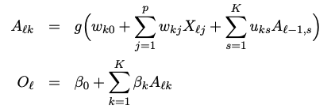

RNN in Detail
Suppose X_{l} = (X_{l1}, X_{l2}, . . . , X_{lp}) has p components, and A_{l} = (A_{l1}, A_{l2}, . . . , A_{lK} ) has K components. Then the computation at the kth components of hidden unit A_{l} is
Often we are concerned only with the prediction O_{L} at the last unit. For squared error loss, and n sequence/response pairs, we would minimize
Notes:
A_{l} = g(\omega_{0\,}+ WX_{l\,}+ UA_{l-1}), where W\in R^K\times p
\sum_{i=1}^n(y_i – o_{il})^2 =\sum_{i=1}^n(y_i - (\beta_0 + \Beta \cdot g(\omega_0 +WX_{iL}+ UA_{I,L-1} )))^2
\sum_{i=1}^{n}(y_{i} - o_{il})^{2} ==\sum_{i=1}^{n}\left(y_{i\,}-\left(\right)\beta_{0} +B \cdot g(\omega_{0} +WX_{iL}+ UA_{I,L-1})\right)^{2}

Slide 8
Outline
Deep Learning Introduction
Deep Learning Model 1: Multilayer Perception
Deep Learning Model 2: Convolutional Neural Networks
Deep Learning Model 3: Recurrent Neural Networks
Use case 1: Sentiment Prediction
Use case 2: Forecast
Deep Learning Optimization
A bag of tricks
Some Interesting Findings in Extremely Deep Neural Networks (ChatGPT)

Slide 9
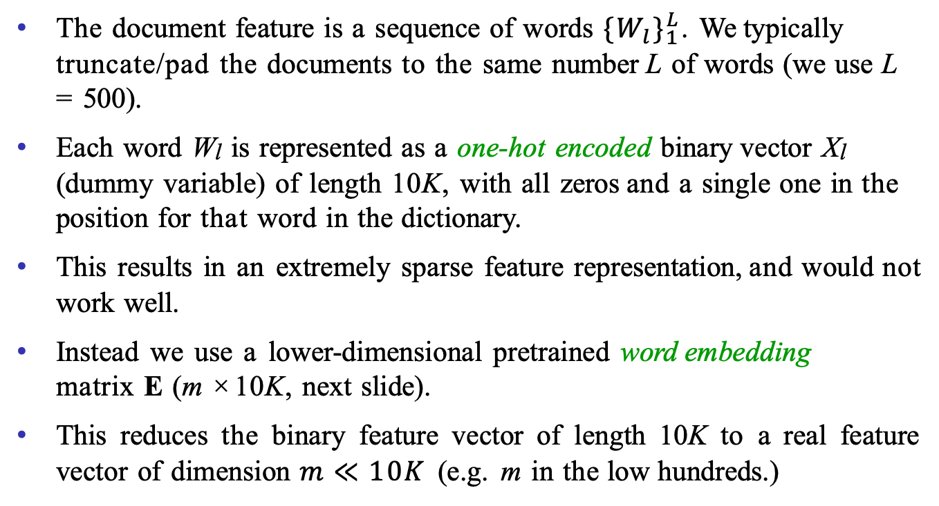
RNN and IMDB Reviews
The document feature is a sequence of words $\{{W_{l}\}}_{1}^{L}$. We typically truncate/pad the documents to the same number L of words (we use L = 500).
Each word W_{l} is represented as a one-hot encoded binary vector X_{l} (dummy variable) of length 10K, with all zeros and a single one in the position for that word in the dictionary.
This results in an extremely sparse feature representation, and would not work well.
Instead we use a lower-dimensional pretrained word embedding matrix E (m × 10K, next slide).
This reduces the binary feature vector of length 10K to a real feature vector of dimension $m≪10K$ (e.g. m in the low hundreds.)

Slide 10
Word Embedding
this is one of the best films actually the best I have ever seen the film starts one fall day ··· .
Embeddings are pretrained on very large corpora of documents, using methods similar to principal components. word2vec and GloVe are popular.

Slide 11
RNN on IMDB Reviews
After a lot of work, the results are a disappointing 76% accuracy.
We then fit a more exotic RNN than the one displayed — an LSTM with long and short-term memory. Here, A_{l} receives input from A_{l-1} (short-term memory) as well as from a version that reaches further back in time (long-term memory). Now we get 87% accuracy, slightly less than the 88% achieved by glmnet.
These data have been used as a benchmark for new RNN architectures. The best-reported result found at the time of writing (2020) was around 95%. We point to a leaderboard (https://paperswithcode.com/sota/sentiment-analysis-on-imdb) in Section 10.5.1.

Slide 12
Outline
Deep Learning Introduction
Deep Learning Model 1: Multilayer Perception
Deep Learning Model 2: Convolutional Neural Networks
Deep Learning Model 3: Recurrent Neural Networks
Use case 1: Sentiment Prediction
Use case 2: Forecast
Deep Learning Optimization
A bag of tricks
Some Interesting Findings in Extremely Deep Neural Networks (ChatGPT)

Slide 13
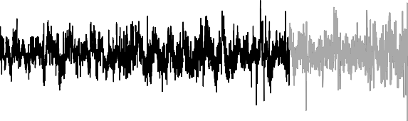
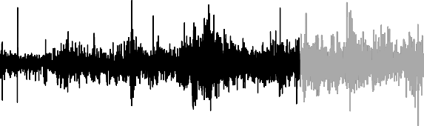
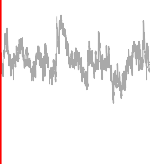
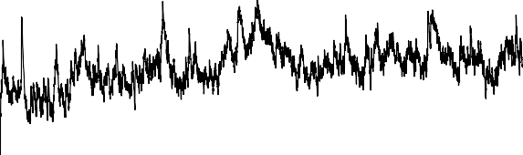
Time Series Forecasting
0.0 0.5 1.0
Log(Trading Volume)
−1.0
0.04
Dow Jones Return
0.00
−9 −8 −0.04
Log(Volatility)
−11
−13
1965
1970
1975
1980
1985

Slide 14
New-York Stock Exchange Data
Shown in the previous slide are three daily time series for the period December 3, 1962, to December 31, 1986 (6,051 trading days):
Log trading volume. This is the fraction of all outstanding shares that are traded on that day relative to a 100-day moving average of past turnover, on the log scale.
Dow Jones return. This is the difference between the log of the Dow Jones Industrial Index on consecutive trading days.
Log volatility. This is based on the absolute values of daily price movements.
Goal: predict Log trading volume tomorrow, given its observed values up to today, as well as those of Dow Jones return and Log volatility.
These data were assembled by LeBaron and Weigend (1998) IEEE Transactions on Neural Networks, 9(1): 213–220.

Slide 15
Autocorrelation
The autocorrelation at lag l is the correlation of all pairs (v_{t}, v_{t−l}) that are l trading days apart.
These sizable correlations give us confidence that past values will be helpful in predicting the future.
This is a curious prediction problem: the response v_{t-l} is also a feature to predict v_{t}!

Slide 16

RNN Forecaster
We only have one series of data! How do we set up for an RNN?
We extract many short mini-series of input sequences
X = {X₁, X₂,. .., X_{L}} with a predefined length L known as the lag:
Since T=6,051, with L =5 we can create 6,046 such (X, Y ) pairs.
We use the first 4,281 as training data, and the following 1,770 as test data. We fit an RNN with 12 hidden units per lag step (i.e. per A_{l}.)

Slide 17
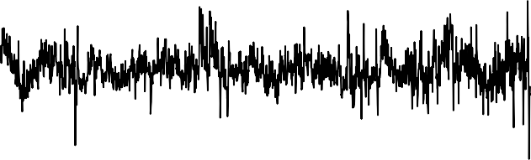
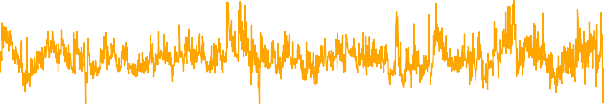
RNN Results for NYSE Data
Test Period: Observed and Predicted
0.0 0.5 1.0
log(Trading Volume)
−1.0
1980
1982
1984
1986
Year
Figure shows predictions and truth for test period.
R² = 0.42 for RNN
R² = 0.18 for straw man — use yesterday’s value of Log trading volume to predict that of today.

Slide 18
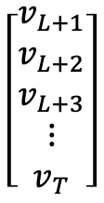
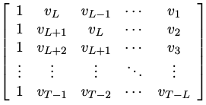
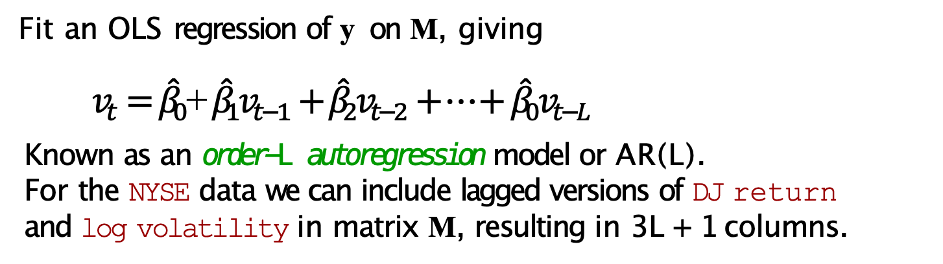
Autoregression Forecaster
The RNN forecaster is similar in structure to a traditional
autoregression procedure.
y =
M =
Fit an OLS regression of y on M, giving
$v_{t}={\hat{β}}_{0}$+ ${\hat{β}}_{1}v_{t−1}+{\hat{β}}_{2}v_{t−2}+…+ {\hat{β}}_{0}v_{t−L}$
Known as an order-L autoregression model or AR(L).
For the NYSE data we can include lagged versions of DJ return
and log volatility in matrix M, resulting in 3L + 1 columns.

Slide 19
Autoregression Results for NYSE Data
R² = 0.41 for AR(5) model (16 parameters)
R² = 0.42 for RNN model (205 parameters)
R² = 0.42 for AR(5) model fit by neural network.
R² = 0.46 for all models if we include day of week of day being predicted.

Slide 20
Summary of RNNs
We have presented the simplest of RNNs. Many more complex variations exist.
One variation treats the sequence as a one-dimensional image, and uses CNNs for fitting. For example, a sequence of words using an embedding representation can be viewed as an image, and the CNN convolves by sliding a convolutional filter along the sequence.
Can have additional hidden layers, where each hidden layer is a sequence, and treats the previous hidden layer as an input sequence.
Can have output also be a sequence, and input and output share the hidden units. So-called seq2seq learning is used for language translation.

Slide 21
When to Use Deep Learning
CNNs have had enormous successes in image classification and modeling, and are starting to be used in medical diagnosis. Examples include digital mammography, ophthalmology, MRI scans, and digital X-rays.
RNNs have had big wins in speech modeling, language translation, and forecasting.
Should we always use deep learning models?
Often the big successes occur when the signal to noise ratio is high — e.g. image recognition and language translation. Datasets are large, and overfitting is not a big problem.
For noisier data, simpler models can often work better.
On the NYSE data, the AR(5) model is much simpler than a RNN, and performed as well.
On the IMDB review data, the linear model fit by glmnet did
as well as the neural network, and better than the RNN.
We endorse the Occam’s razor principal — we prefer simpler models if they work as well. More interpretable!

